Slide 1


Genetic Programming for Ocean Microbial
Ecology and Biodiversity
John R. Moisan
NASA/GSFC
Earth Science Division
Code 610.W
John.R.Moisan@nasa.gov
23 April, 2015

Slide 2
Outline
Overview of Genetic Programming Achitecture
Evolving Satellite Algorithms
Modeling Phytoplankton Traits
GP Evolution of Ecosystem Models
Twin Experiment Solutions
Global Ocean CDOM/Mixed Layer Dynamics
Future Directions

Slide 3
“…the simple sad fact is that not for a single clone of a plankton species can we construct a model describing its activity under a realistic range of environmental conditions. This is before we consider the impact of genetic diversity.”¹
¹Flynn, K. J., Reply to Horizons Article ‘Plankton functional type modelling: running before we can walk’ Anderson (2005): II Putting trophic functionality into plankton functional types, J. Plankton Res., 9, 873-875, 2006

Slide 4
Phytoplankton Ecological Function
Feeding Growth, Reproduction, Pop. Expansion Survival
Body Size
Shape (Volume to Biomass Ratio)
Reproductive Fecundity
Defenses
Nutrient/Energy Source
Color
Mixotrophy?
Maximum Growth Rate
Bioluminescence
Phytoplankton Trait Type
Stoichiometric Requirement/Content
Senescence
Life History Behavioral Physiological Morphological
Pigment Suite
Basal Metabolic Rate
Photoacclimation
Motility (Pattern/Speed)
Vertical Migration
Sexual/asexual Repoduction
Reproduction Frequency
Microbial Relationships (Phycosphere)
Adapted from: Litchman et al., J. Plankton Res. (2013) 35(3): 473–484

Slide 5
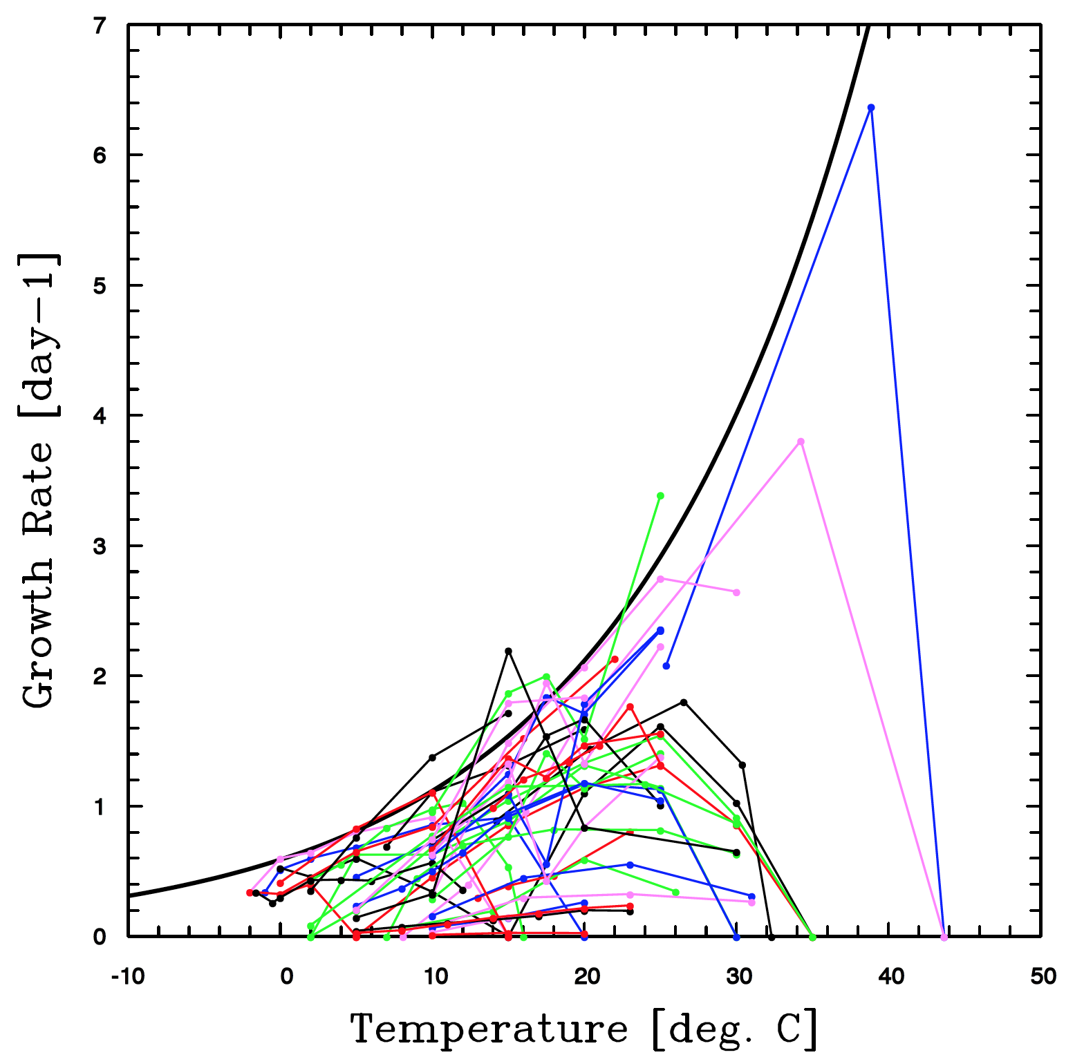
Phytoplankton Maximum Growth Rates
“Eppley Curve”
Eppley, R.W., 1972. Temperature and phytoplankton growth in the sea. Fishery Bull. 70, 1063–1085.

Slide 6
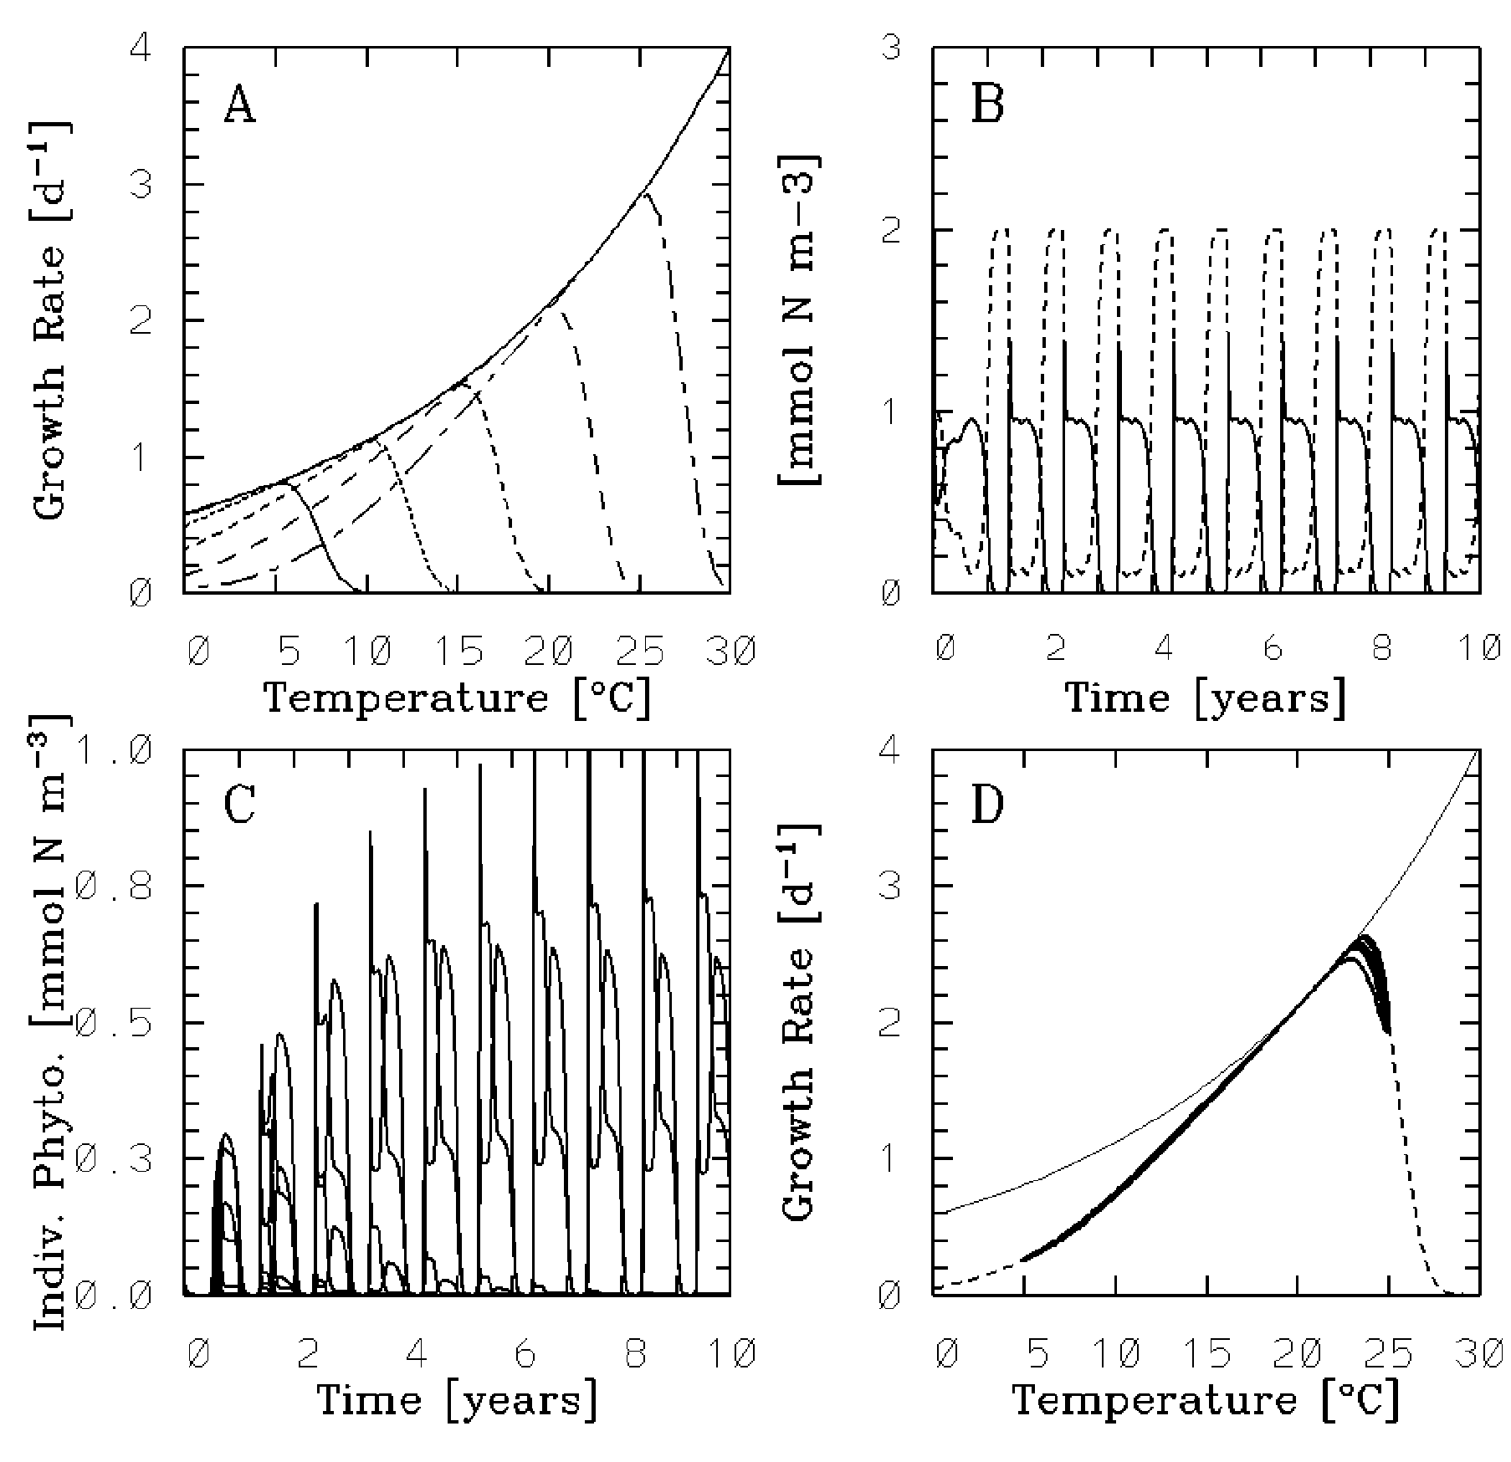
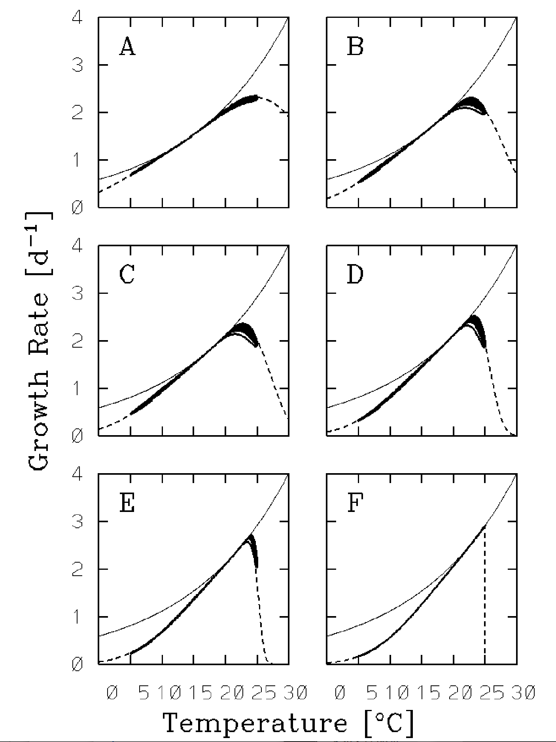
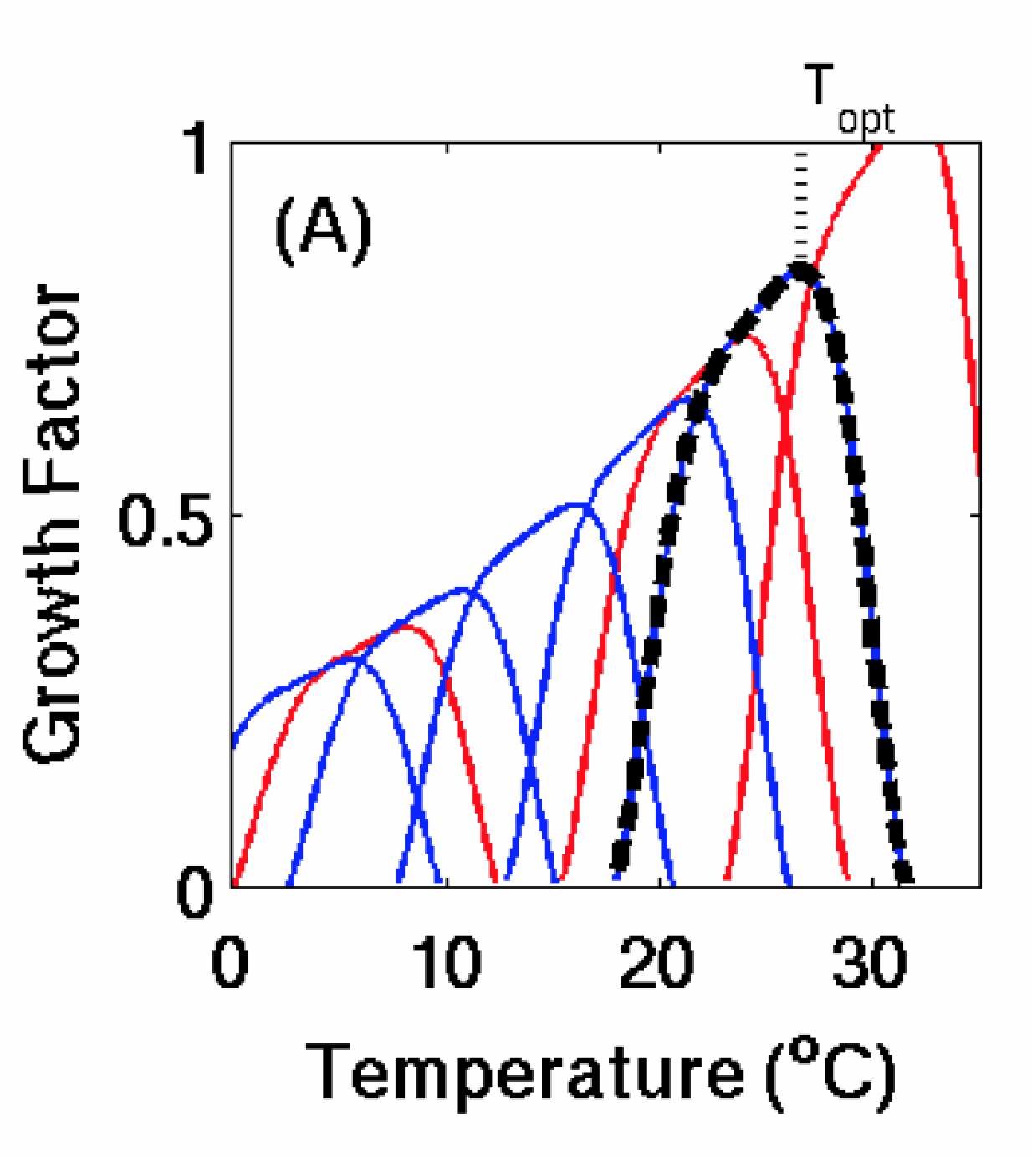
“Everything is everywhere, but the environment selects*”.
Moisan et al., 2002
Moisan et al., 2002
Follows et al., 2007
*Bass Becking, 1934
Notes:
Results from simulations in Moisan et al. 2002 with less than 100 phytoplankton groups deviate from the results obtained with higher numbers of phytoplankton.
Becking, Bass, 1934. Geobiologie of inleiding tot de milieukunde. The Hague, the Netherlands: W.P. Van Stockum & Zoon (in Dutch).

Slide 7
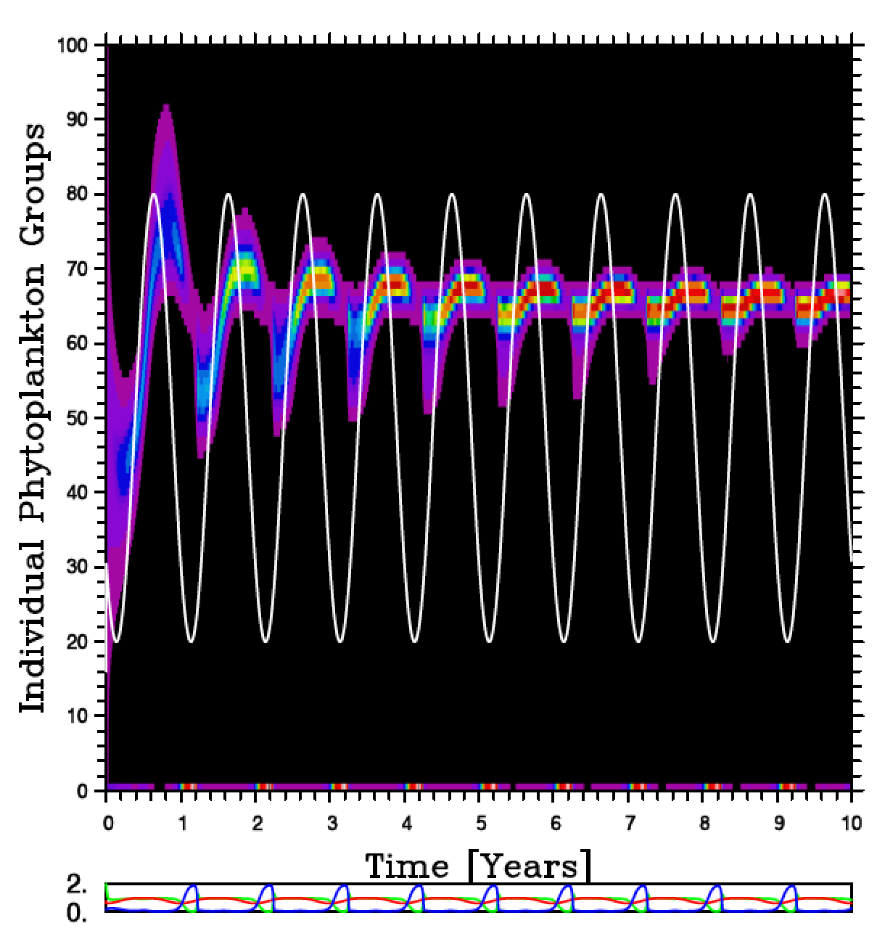
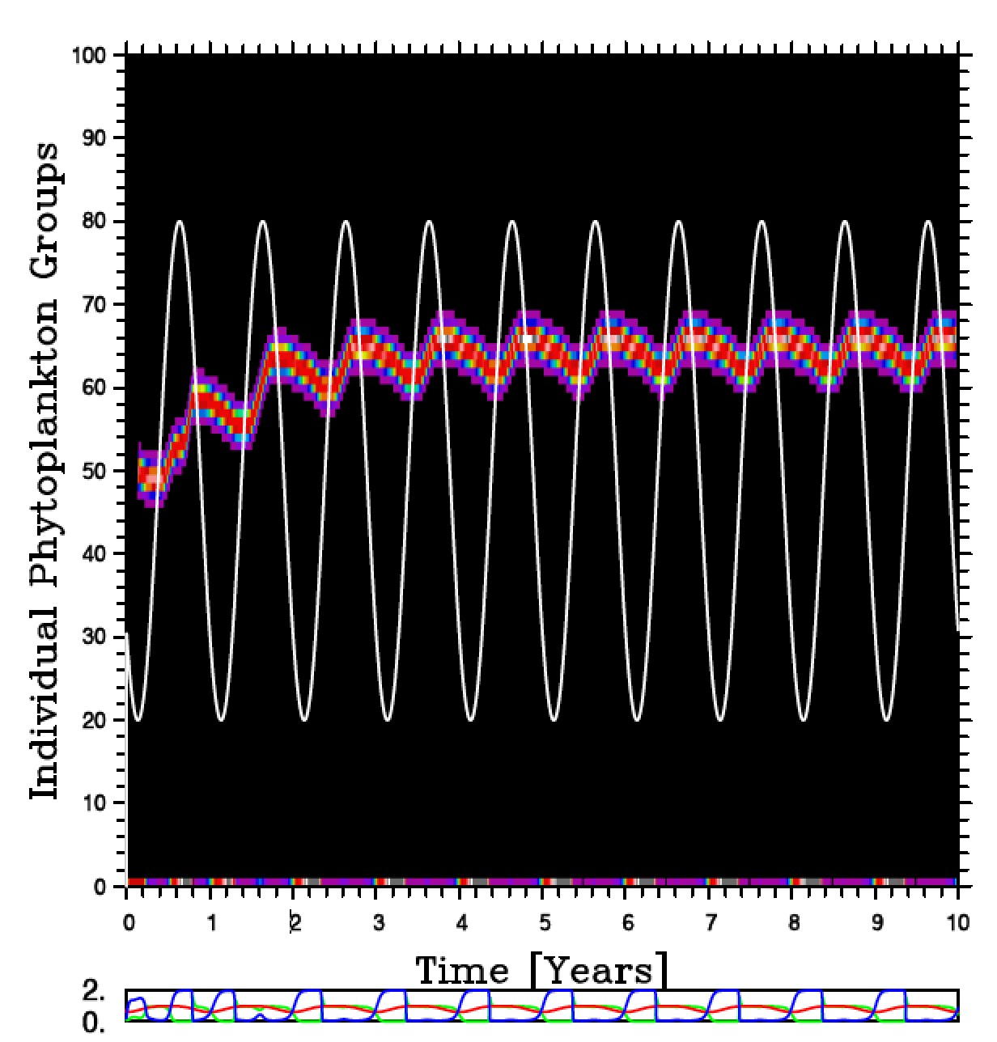
Linking parameters to traits for diversity and acclimation
Model with 100 phytoplankton groups
Gaussian Trait-based model (2-3 equations)

Slide 8
Genetic Programming Overview
Generate initial random population of models/equations
Calculate fitness of all individual models/equations
Randomly select based on fitness for:
  Asexual reproduction
  Sexual reproduction (i.e. Tournament Selection)
Carry out genetic mutation (these are rare events ~<1%)
Introduce ‘recruited’ individuals [NEW MODIFICATION]
Run combination of Genetic Algorithm/lmdif* routine to optimize the model parameters. (*Golfing Analog)
Calculate fitness of new individuals
Test for completion criteria (low SSE value met?)
No: go to 3; Yes: end program

Slide 9
Use of Fortran-90 ‘Defined Type’
Operator:
[+,-,*,/,Boolean,etc]
Input nodes can vary.
Input Nodes:
[Variable, parameter,
New defined type]
Calculation starts from top of tree
Performance improved by orders of magnitude!

Slide 10
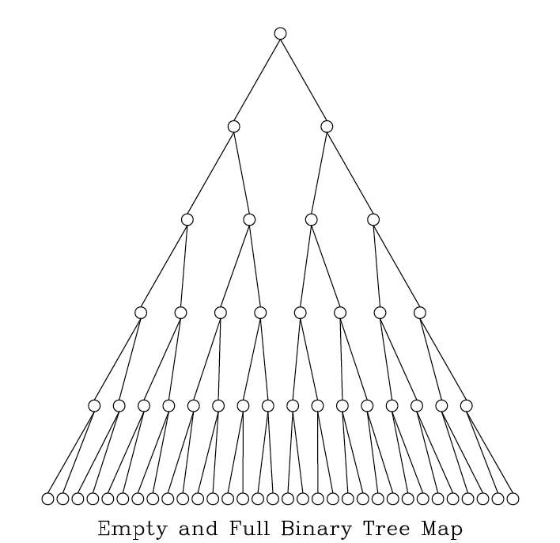
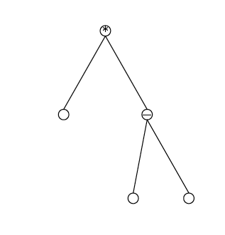
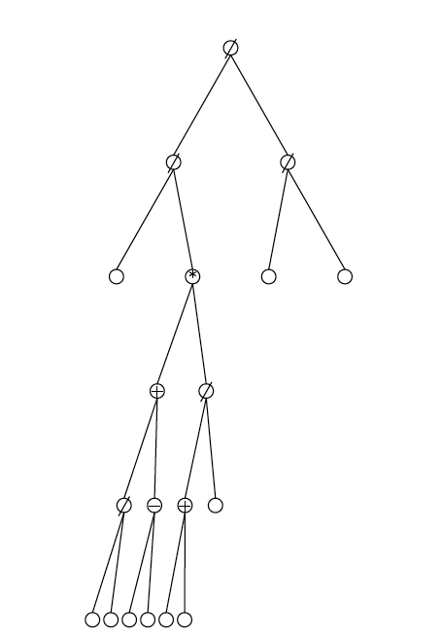
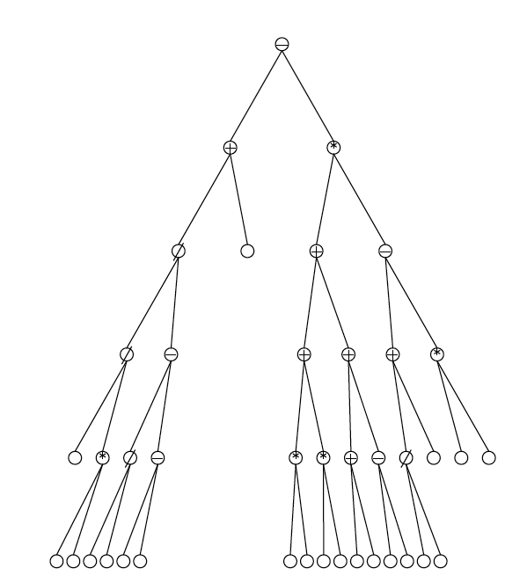
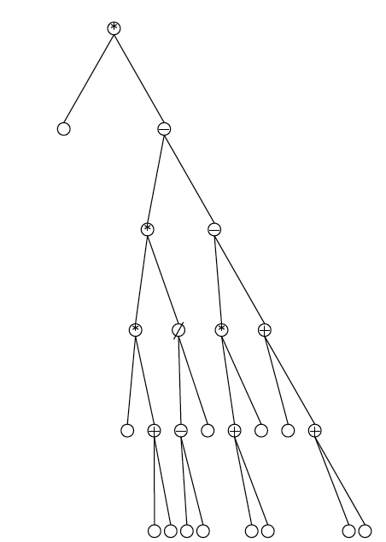
Binary Tree Architecture
Nodes are operators (+, -, /, *, boolean, etc)
Terminals are variables or forcing
parameters
Examples of randomly generated initial tree/lisp structures
Notes:
Binary trees are simple to archive and manipulate using standard fortran or c code. But, they have serious overhead for those codes that require large number of computational levels.

Slide 11
LISP prefix representation:
(* V_{m} (* (/ N (+ (K_{N} N))) (/ I (+ (I_{K} I)))))
*
Calculation of Tree
value moves from
the bottom up.
*
V_{m}
/
/
N
+
I
+
K_{N}
N
I_{K}
I

Slide 12
Parent #1 Parent #2
Cross
methodology
*
*
Randomly
Chosen
Nodes or
Terminals
Before Cross
After Cross
+
6
+
6
3
/
3
4
4
2
Child #1 Child #2
Related
Subtrees are
Swapped
*
*
+
+
/
6
3
6
3
4
4
2

Slide 13
Use of Genetic Programming to Evolve
Satellite Algorithms

Slide 14
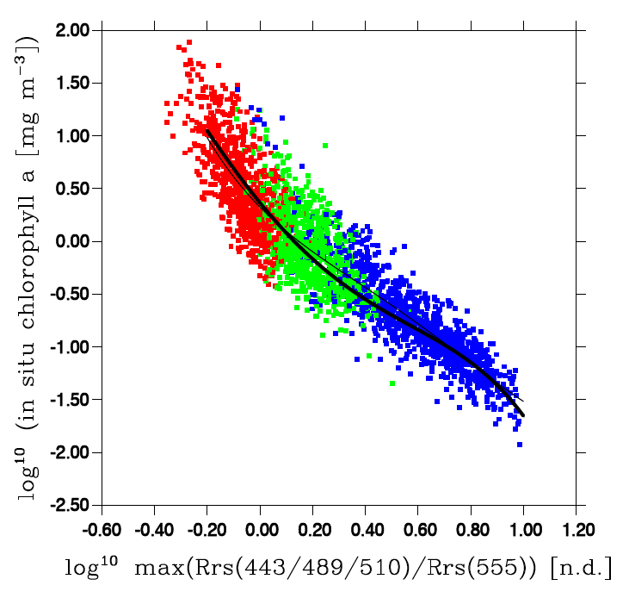
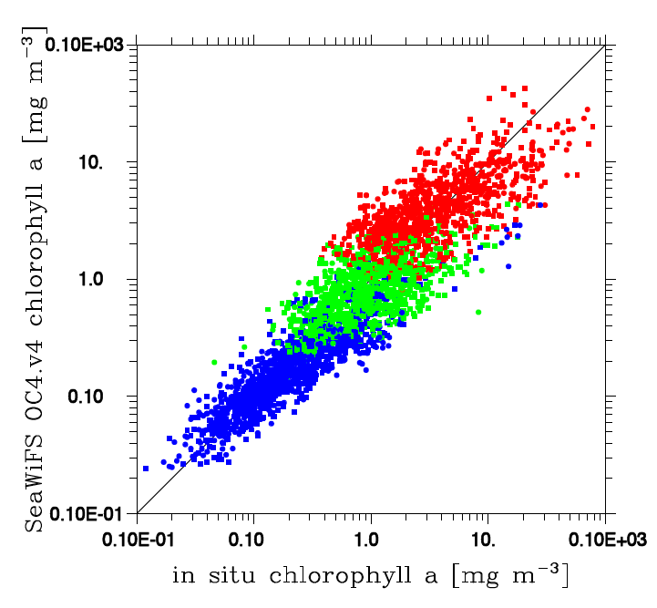
log-log data from the NOMAD data set
OC4 fit to log-log data
Comparison of OC4 to in situ chla (log-log scale)
Color denotes changes in the maximum ratios

Slide 15
OC4 Algorithm in Binary Form
8-level binary tree

Slide 16
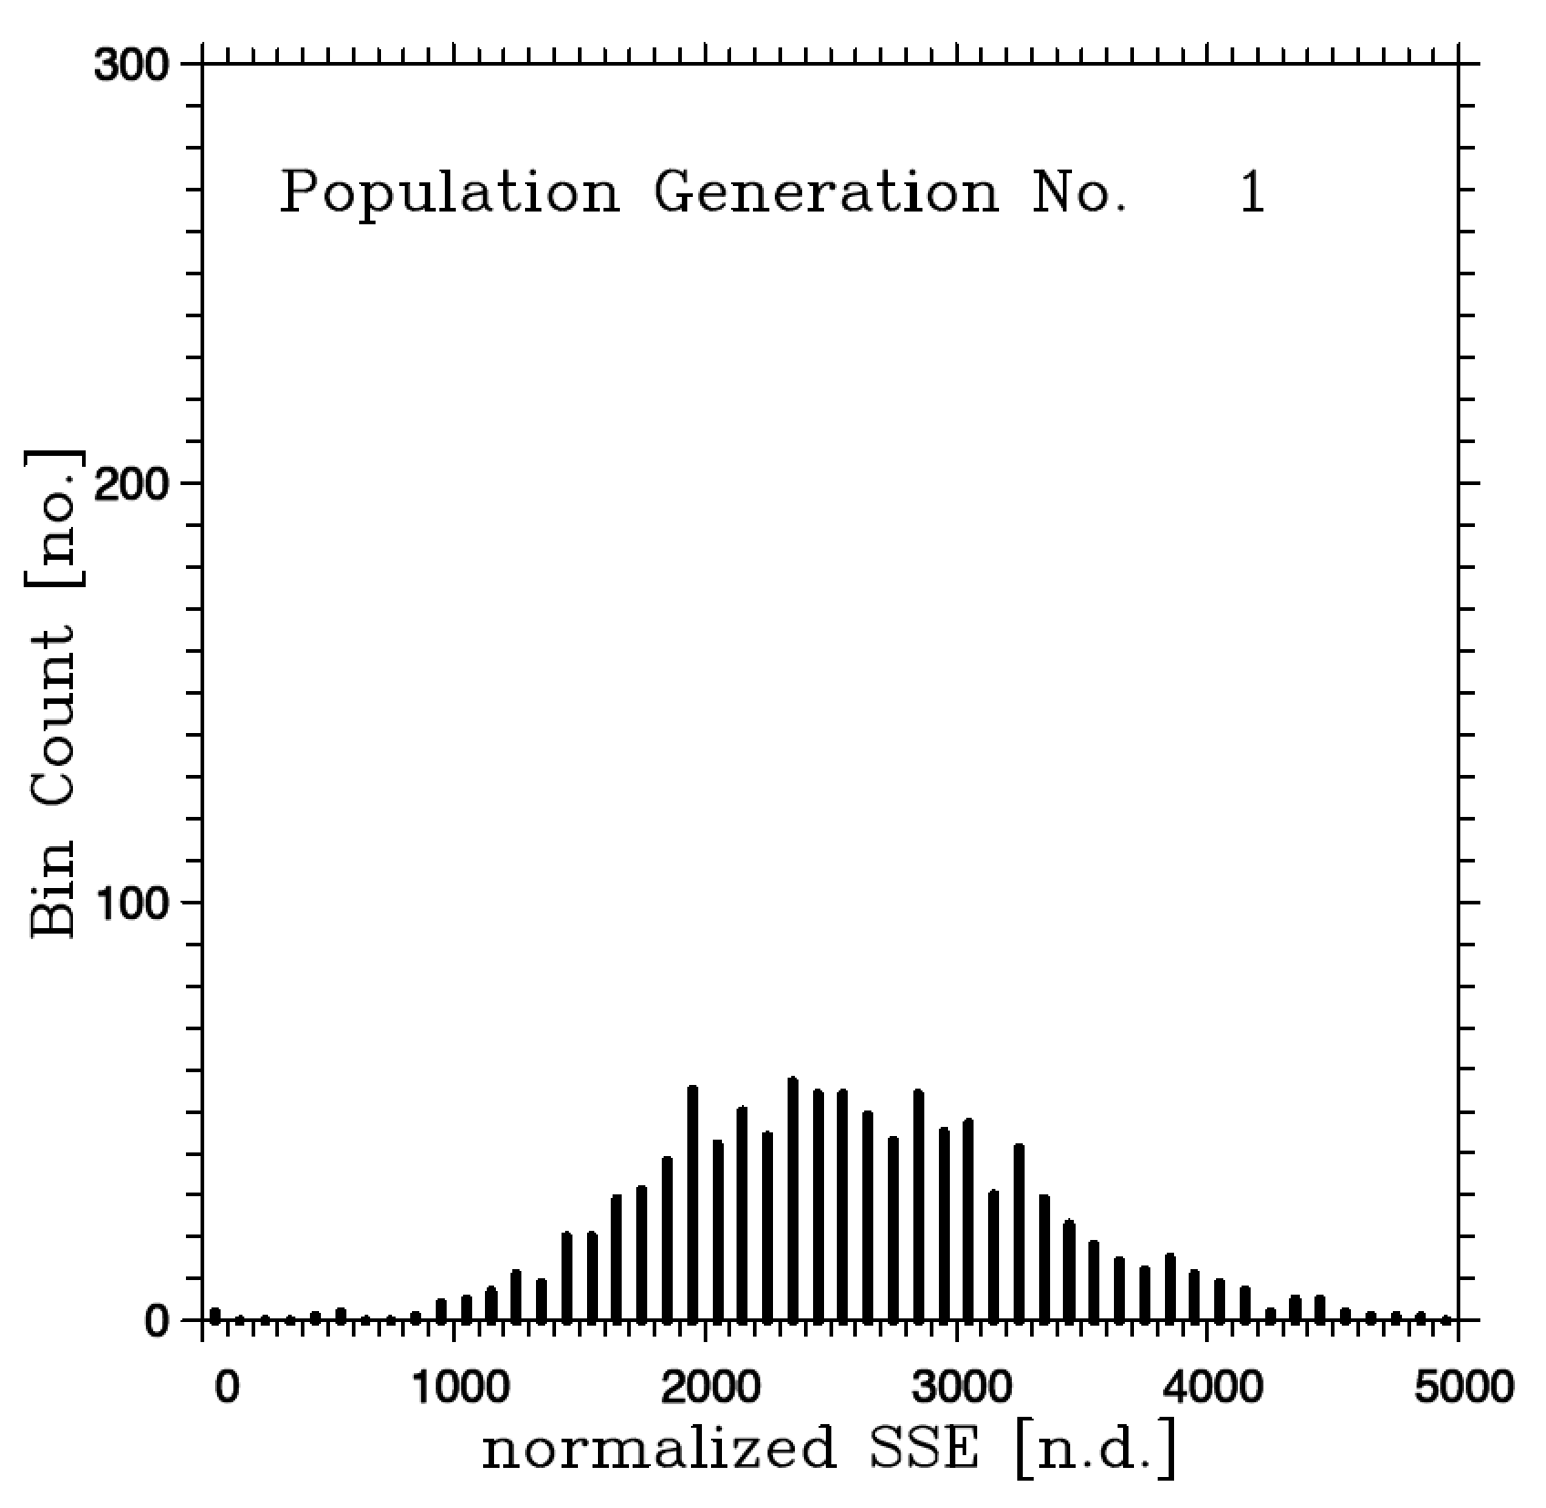
Example Error Field from 1st Population
Notes:
N*N – N = 2*2 -2 = 2 linked flows

Slide 17
Evolution of chlorophyll algorithm with GPCODE
OC4 SSE
Generation [no.]

Slide 18
GPCODE Algorithm in Binary Form
8-level binary tree
(1) Coastal regions have
high conc of CDOM
with relatively slow
photodegradation rates.
(2) The N.E. Pacific
Subpolar Gyre has
high CDOM conc.
with relatively rapid
photodegradation rates.
(3) Central subtropical
Gyres have low conc. of
CDOM and slow
photodegradation rates.

Slide 19
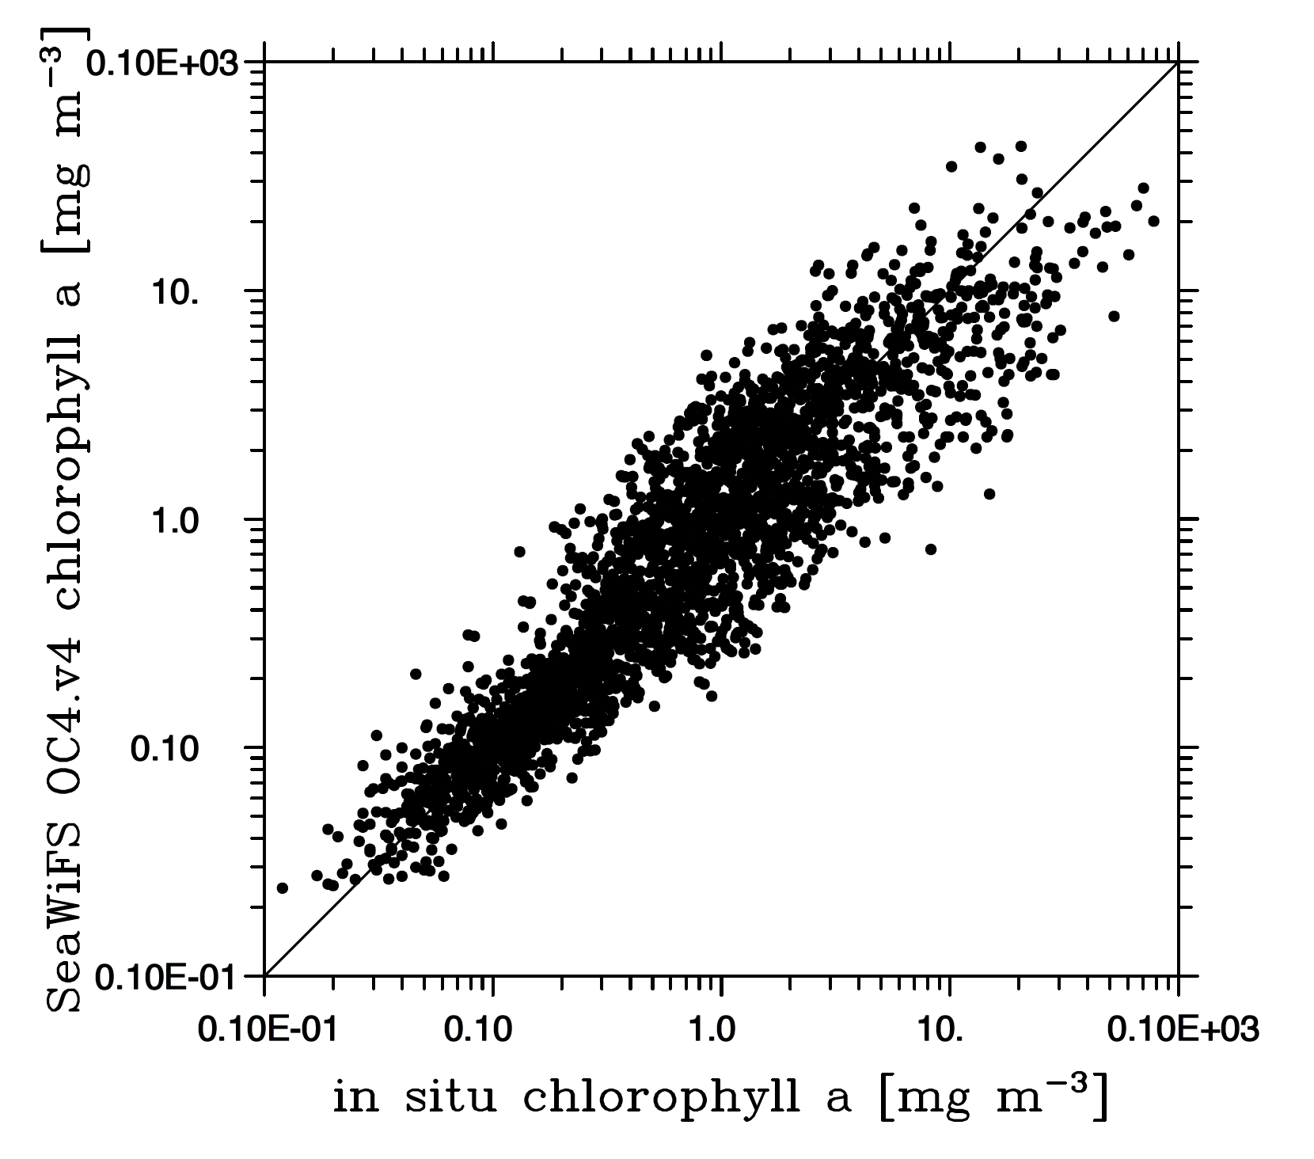
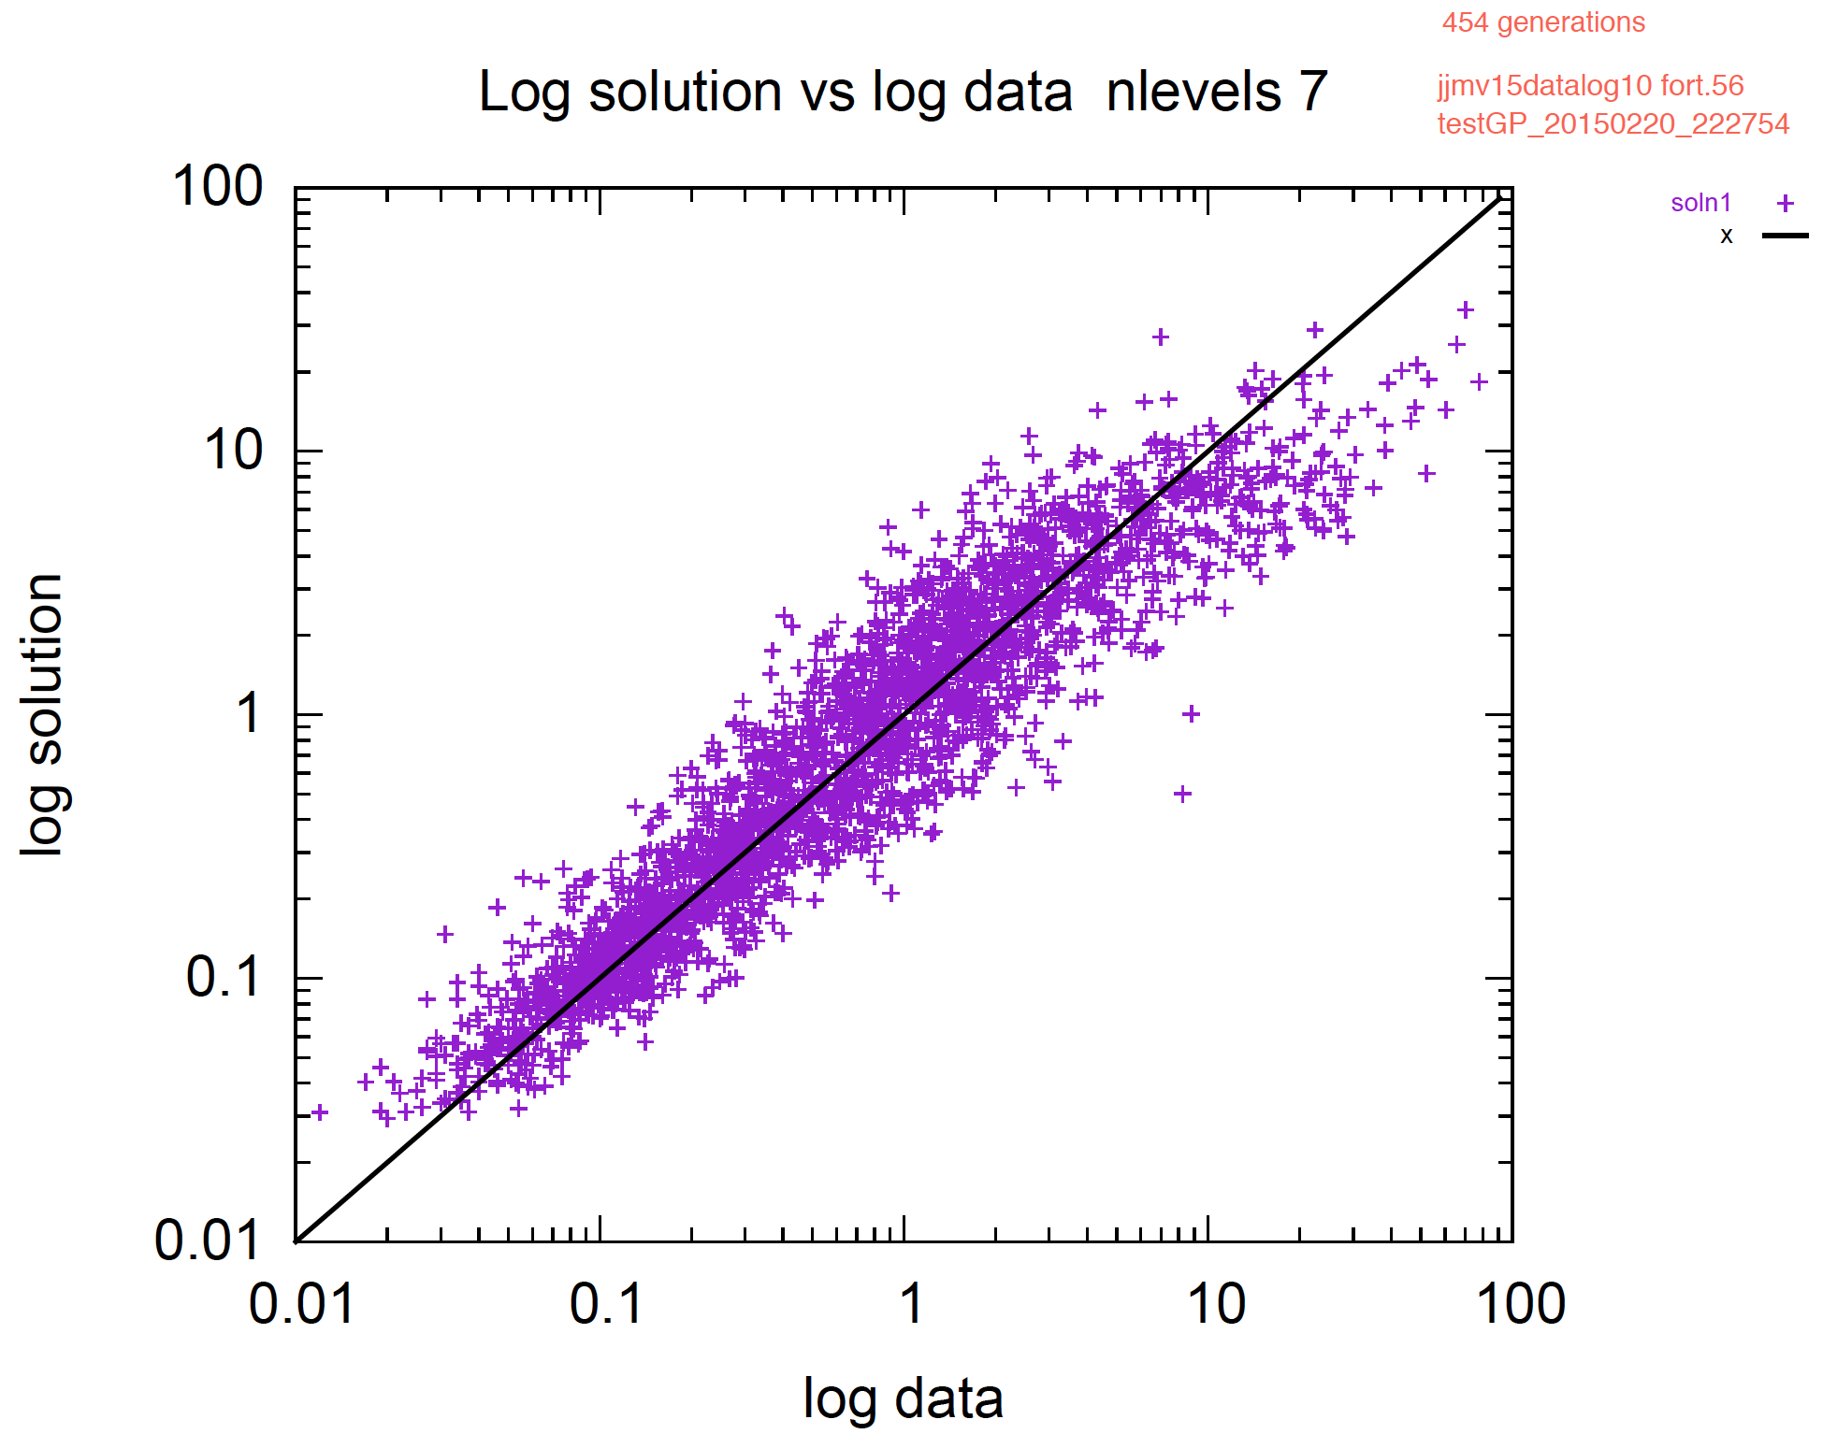
OC4 vs. GPCODE

Slide 20
Use of Genetic Programming to Evolve Ecosystem Models

Slide 21
Satellite Algorithms:
Box Models
One Dimensional (Vertical) Models
Three Dimensional Models
Notes:
The right-hand-side term in satellite algorithms, box, simple 1D or complex 3D models are single or groups of equations.

Slide 22
Box Models
Notes:
In coupled ecosystem models, these equations control the rate of change of a model’s components. For instance, in the simple Nutrient-Phytoplankton-Zooplankton box model (time dependent only, no explicit spatial dependence), a single equation calculates the rate of loss of nutrients due to uptake by phytoplankton and the rate of gain from excretion, sloppy feeding and mortality processes of zooplankton.

Slide 23
Box Models
Notes:
A problem in simply trying to evolve any given equation in these coupled systems is that the individuals terms within any given equation is coupled to another equation. For instance, the loss within the nutrient pool due to phytoplankton uptake is also a gain within the phytoplankton pool.

Slide 24
Ecosystem/Food Web Models can be represented as a matrix of terms/equations
Sink
N
P
Z
Nitrate (N)
Nitrate (N)
N
X
X
Source
Phyto (P)
P
X
Phyto (P)
Z
X
Zoo (Z)

Slide 25
Lotka-Volterra System N=2
[0] Sink
[1] Phytoplankton
[2] Zooplankton
*
[0] Source
δ
P
1
2
*
ω
Z
[1] Phytoplankton
*
P
Z
3
4
+
*
*
η
Z
[2] Zooplankton
*
*
ϕ
P
ω
Z
5
6
Total RHS = Sum of Source Terms – Sum of Sink Terms; Total Possible Equations = (N)²-(N)=6

Slide 26
NPZ, Franks et al., Mar. Bio. 1986 N=3
S_{i}
N
P
Z
S_{o}
1
2
3
5
*
*
V_{m}
N
MM
P
4
5
6
*
K_{N}
N
P
7
8
9
Z
*
10
11
12
9
Z
*
β
1e
λ
P
8
11
+
*
*
*
ς
*
Z
g
m
P
*
1e
β
Z
λ
P
Total RHS = Sum of Source Terms – Sum of Sink Terms;
Total Possible Equations = (N+1)²-(N+1)=12; N=3

Slide 27
Ecosystem Model Twin Experiments
Lotka-Volterra Equation Set (2 system ODE)
  Closed system model dependent on I.C.
  Completed
NPZ model of Franks et al. 1986 Mar. Biol.
  Open system box model, dependent on forcing.
  Completed
Fasham et al., 1990 Mixed-Layer Model
  Mixed-layer model, dependent on forcing.
  Completed.
Huisman & Weissing, 1999 [chaos model]
  Multi-species box model with chaotic solutions.
  In Progress.
ECCO Ecosystem Model
  Global randomized ecosystem model with varying geo-located solutions.
  In Progress.

Slide 28
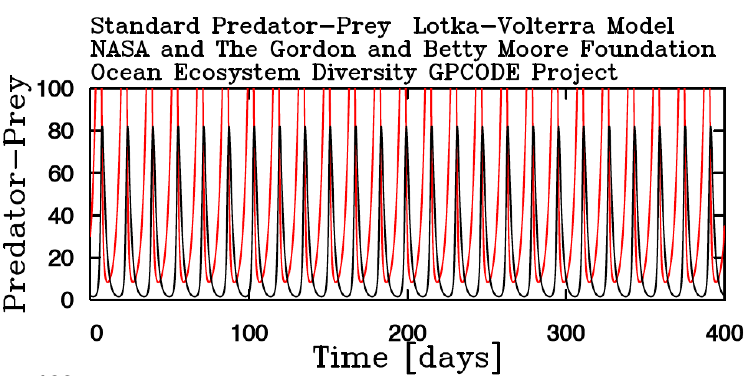
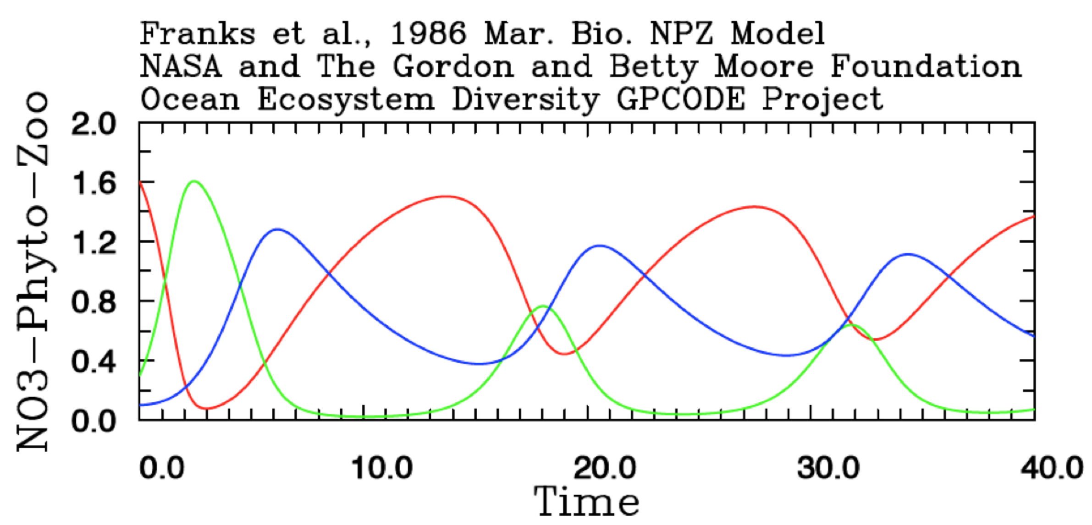
GPCODE Box Model Twin Experiments

Slide 29
Simple Lotka-Volterra Model
Notes:
N*N – N = 2*2 -2 = 2 linked flows

Slide 30
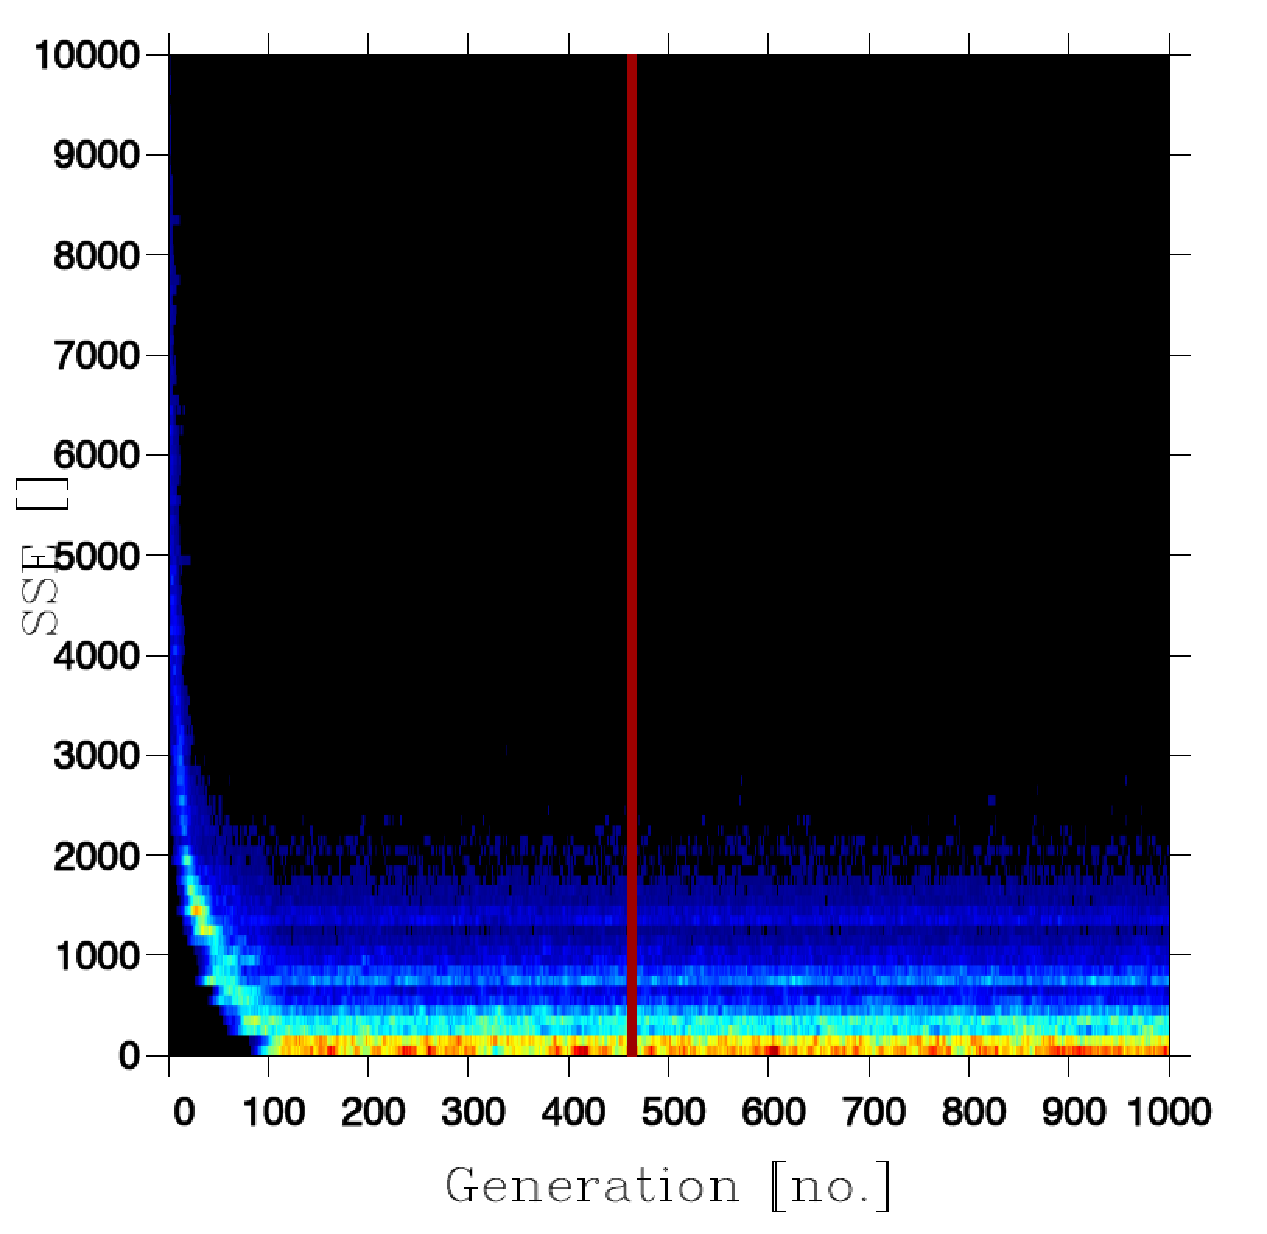
Normalized SSE []
Generation Number [n.d.]

Slide 31
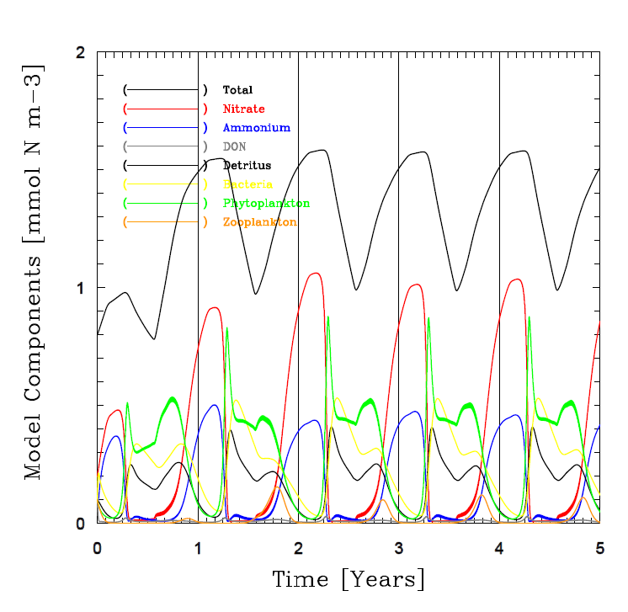
Fasham et al., 1990 Mixed-Layer Ecosystem Model
(BATS Simulation)

Slide 32
Progression of Fasham et al. 1990 Model Twin Experiment Solution
Poor diversity causes too quick a solution
and results in a poor model/outcome.
Healthy diversity supports a continued
evolution to an optimal solution for
a model equation set*.
*Difference in SSE levels between Left and Right panels from longer (t) solutions (N)

Slide 33
CDOM and Mixed Layer Model
Global GP Modeling, starting simple
Simple one equation model (ODE)
Utilizes ECCO-2 model and results and SeaWiFS observations.
  ECCO-2: MLD
  SeaWiFS: PAR, aCDOM, Kd
Globally significant solutions
  Ocean Color Retrieval Errors
  Carbon Cycle Dynamics
  Mixed-Layer Observations/Upper Ocean Heat Budget.

Slide 34
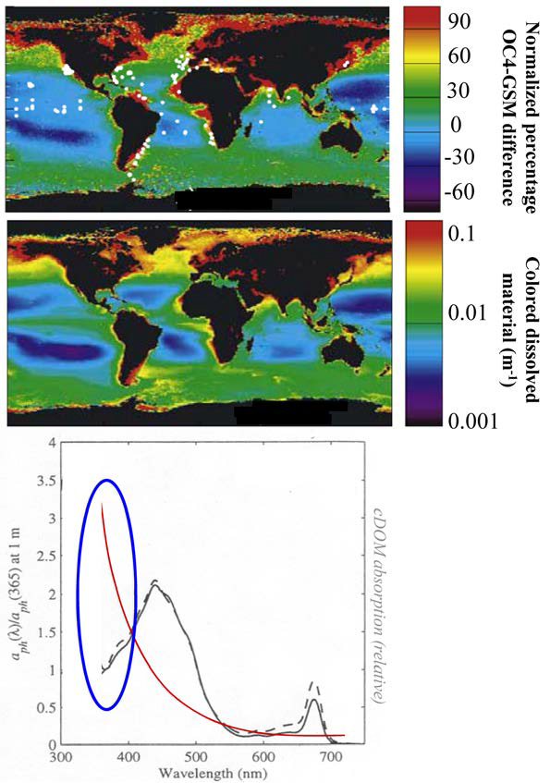
Why model global CDOM dynamics?
Because it is correlated with ocean color inverse model solution errors.
Figure obtained from: PACE SDT Final Report: Figure 2.2

Slide 35
A two-parameter CDOM model for the ocean Mixed Layer
Photodegradation Injection into ML
This CDOM model can be rearranged to create a model that predicts Mixed-Layer Depths (MLD) using satellite observations of PAR₀, a_{CDOM} and K_{d}
A two-parameter Mixed Layer Model
Black: product; Red: model parameters; Blue: observations
δ: PAR-specific photodegradation rate [(W m⁻²)⁻¹ d⁻¹]; a_{BLM_CD} : CDOM absorption below the mixed layer [m⁻¹]

Slide 36
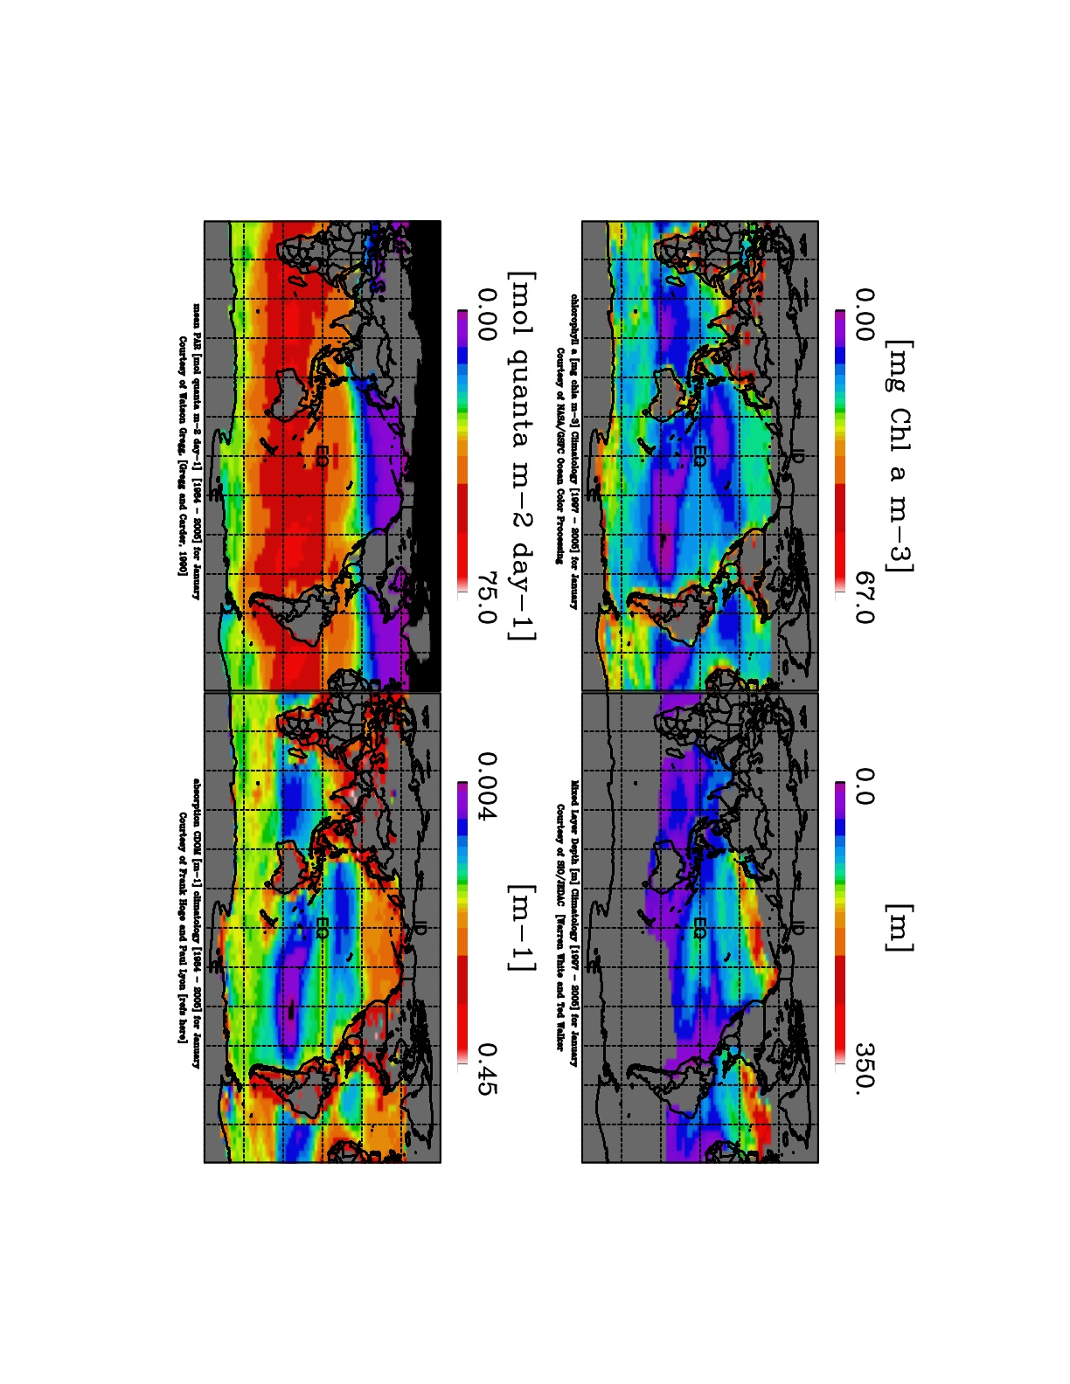

Slide 37
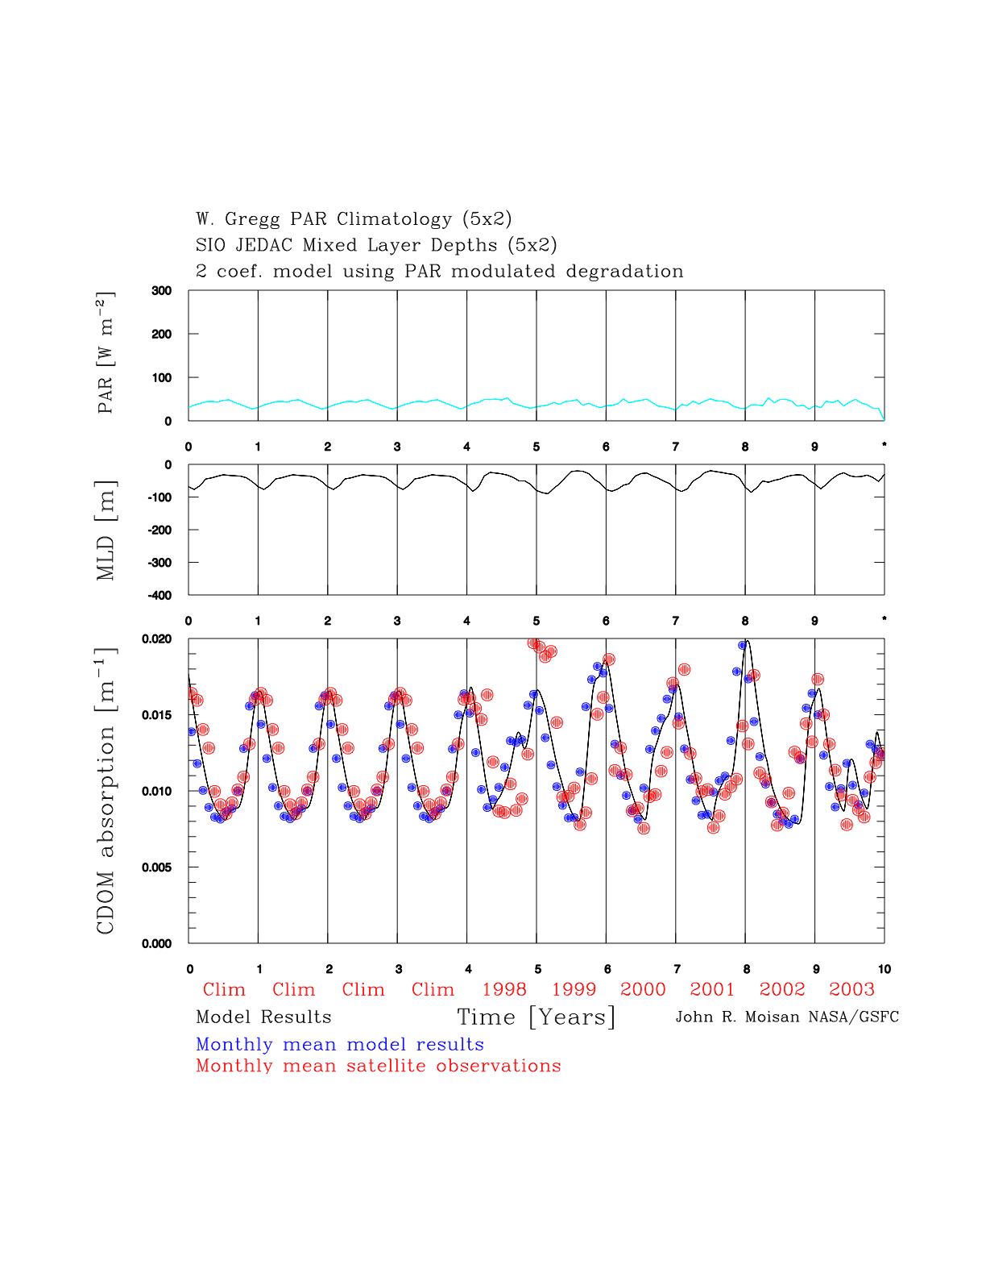
Forward Model Solutions (clim + 1998-2003)

Slide 38
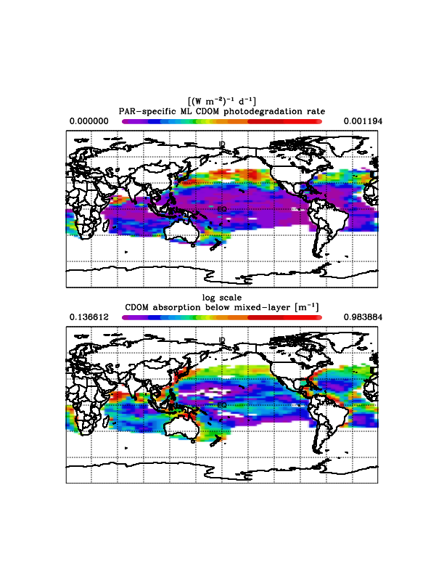
Global bitmap plots of fitted coefficients from simple CDOM Model presented above
(1) Coastal regions have
high conc of CDOM
with relatively slow
photodegradation rates.
(2) The N.E. Pacific
Subpolar Gyre has
high CDOM conc.
with relatively rapid
photodegradation rates.
(3) Central subtropical
Gyres have low conc. of
CDOM and slow
photodegradation rates.

Slide 39
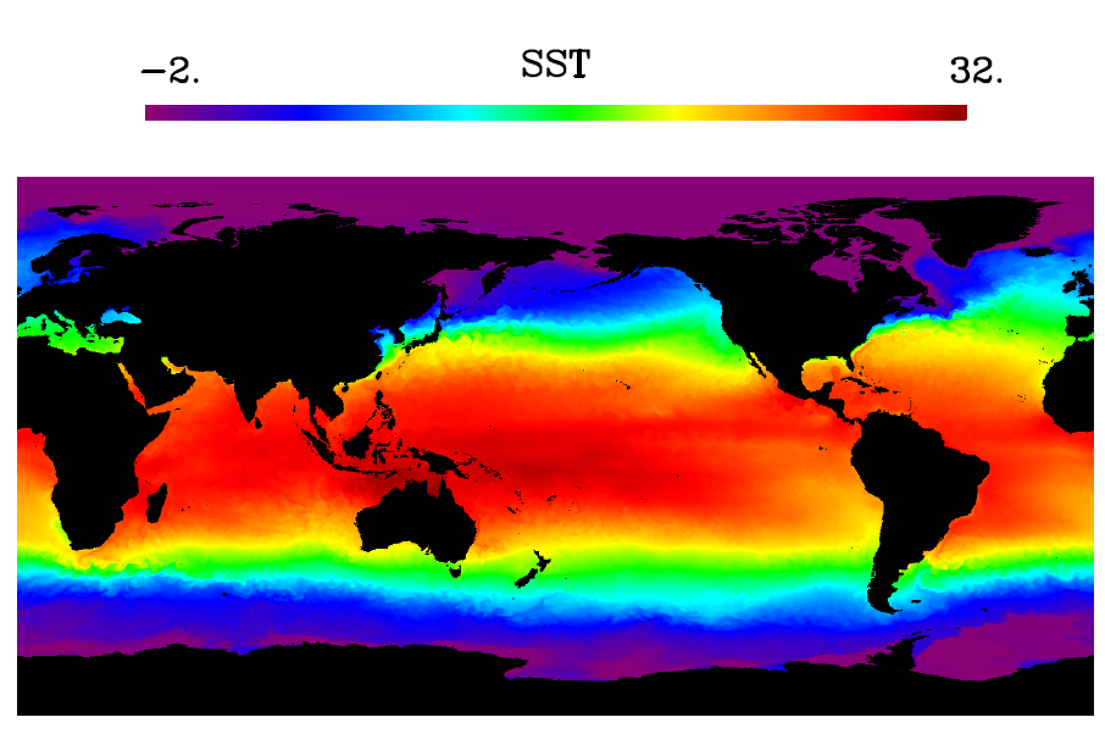
ECCO2 1992-2013 SST Solutions
GP Year 2 Task 2: Begin off-line global GPCODE
modeling experiments

Slide 40
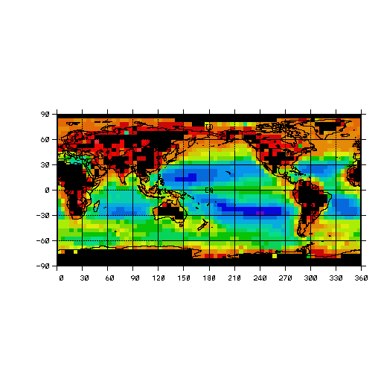
GP Year 2 Task 2 (cont’d): Develop GPCODE
global modeling at coarse scales using
satellite observations
5 deg X 5 deg SeaWiFS mean chl. a

Slide 41
CDOM GPCODE Equation Matrix

Slide 42
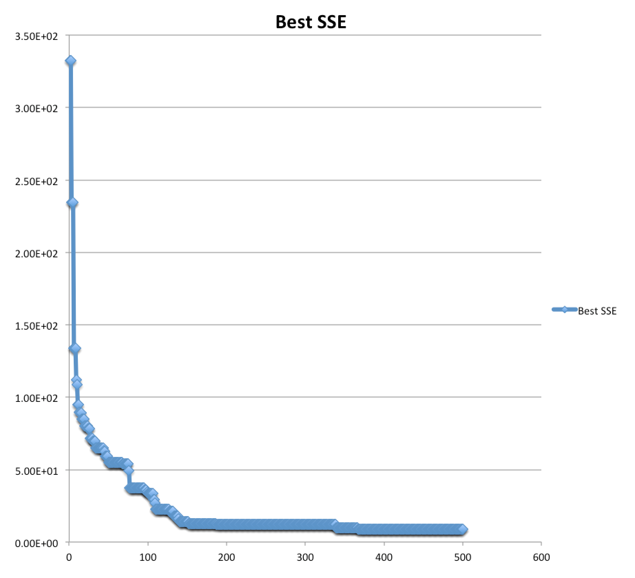
Value [SSE] of BEST Individual Model vs. Generation
SSE [n.d.]
Generation [no.]

Slide 43
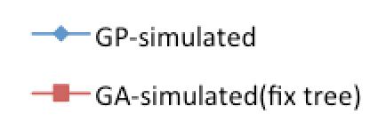
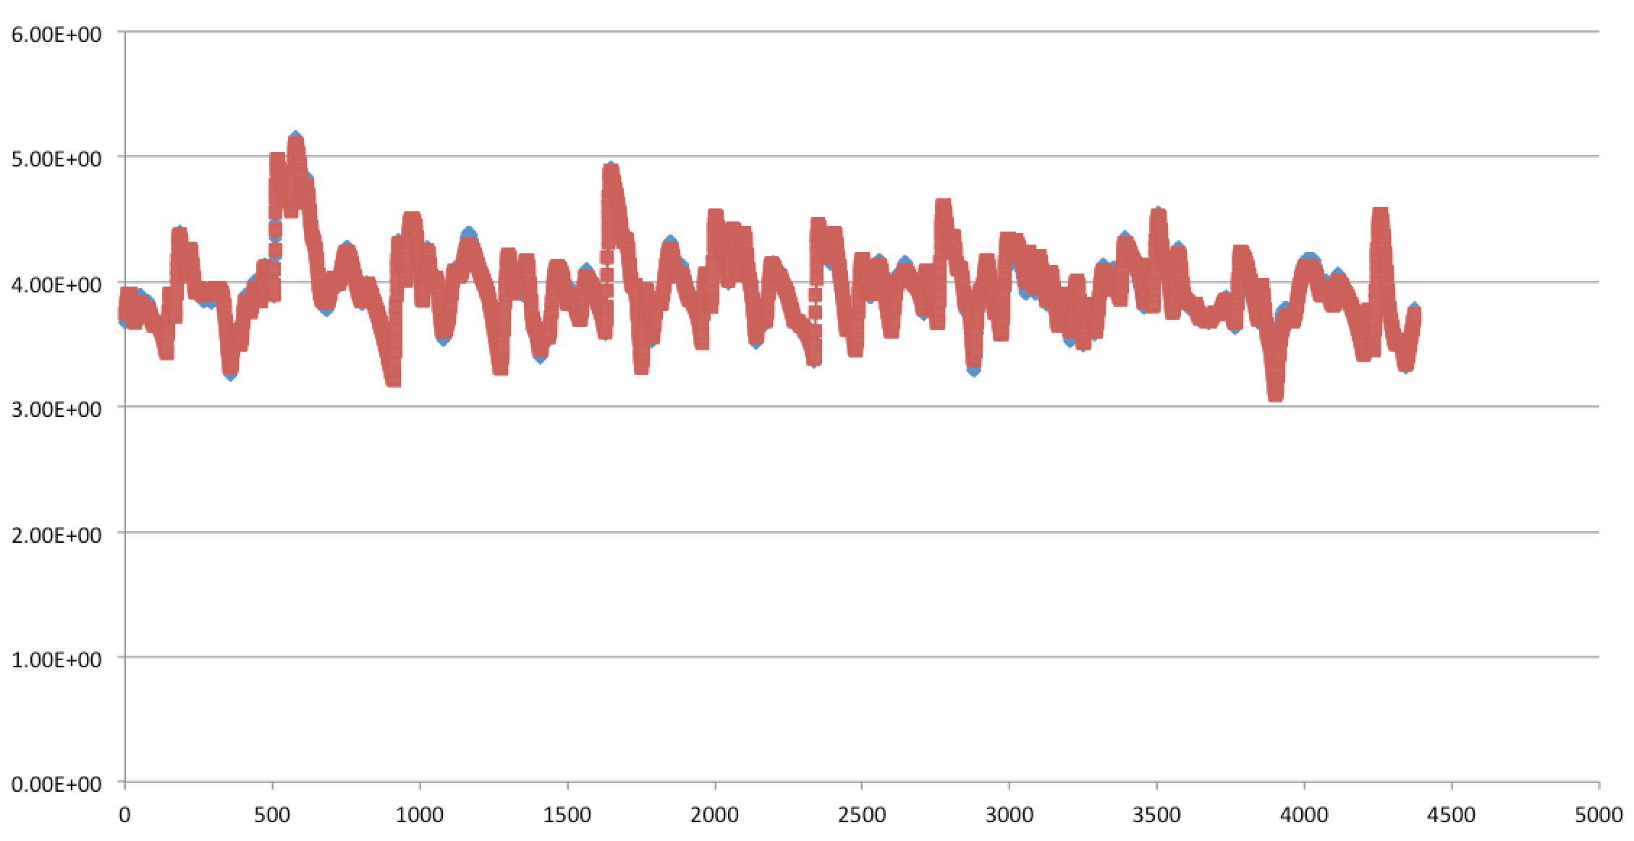
CDOM Twin Experiment Solution
CDOM Absorption Coefficient [n.d.]
Time [Days]

Slide 44
Thank You.

